Slide 1


ASP.NET MVC (2) Controller
小朱 (Azure MVP)
微軟開發技術玩家
高雄在地 .NET 社群義工

Slide 2
About Me
現職：
奇豐資訊、志凱科技、保經科技技術顧問
台灣微軟資深講師、MSDN 講師兼客座作者
Microsoft Azure 種子講師
twMVC/Skilltree 客座講師
studyazure.com 雲端學堂小編
著作
Microsoft Azure 教戰手札 3/e (ITP與DEV分版) – 今年必出 ☺
ASP.NET MVC 網站開發美學：MVC 6 與 SignalR 補遺篇 (協作，書名暫定) – 今年必出 ☺
Windows Azure Platform 應用程式開發教戰手札 2/e
ASP.NET MVC 5 網站開發美學 (協作)
HTML5 and JavaScript 程式開發實戰 (審校)

Slide 3
Agenda
上半場 (19:40-20:20)
Controller Concepts
Understanding ASP.NET Routing
Understanding Action Result
下半場 (20:30-21:10)
View Data, View Bag and Temp Data
Model Binding and Validation
Filters

Slide 4
上半場

Slide 5

MVC Pattern Architecture

Slide 6
Recaps
上半場
Controller Concepts
Understanding ASP.NET Routing
Understanding Action Result
下半場
View Data, View Bag and Temp Data
Model Binding and Validation
Filters

Slide 7
Controller
Handling requests.
Manipulate data from Model.
Binding View and Model results.
Controller and Action
Controllers process incoming requests, handle user input and interactions, and execute appropriate application logic.
Action methods typically have a one-to-one mapping with user interactions.

Slide 8
MVC Controller vs. Web Form Page
MVC Controller
Web Form Page
標準的 HTTP 動作。
由 ASP.NET Routing 依 URL 自動搜尋並呼叫 (MapRoute())。
由 Action 來處理與回應要求。
無須特別處理 View 的部份。
標準的 HTTP 動作，但使用 ViewState 等機制模擬出 Event-Driven Programming 的架構。
ASP.NET 4.5 起支援 ASP.NET Routing (MapPageRoute())
由事件處理常式來回應要求。
須特別處理 View (因為控制項的關係)。

Slide 9
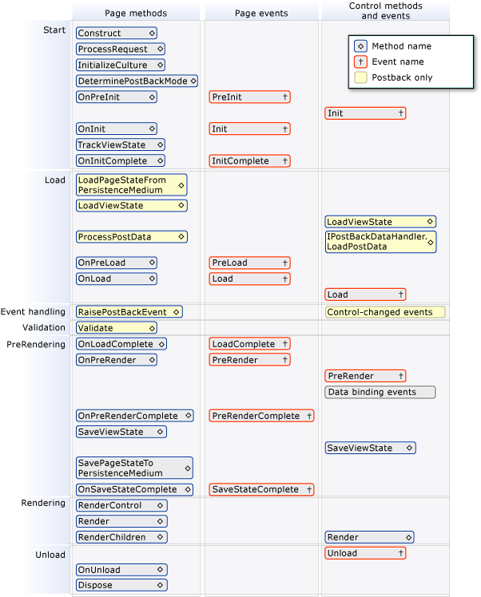
Web Form Page Lifecycle

Slide 10
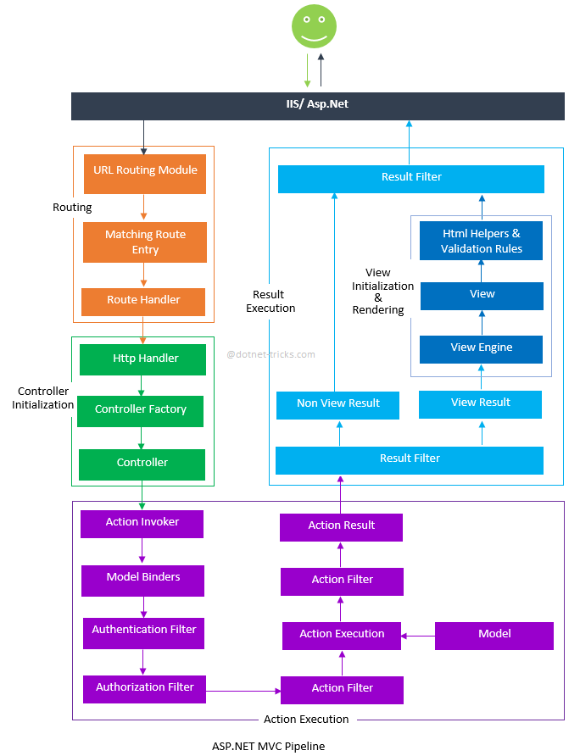
MVC Controller Lifecycle

Slide 11
Controller
MVCHandler creates a controller factory.
Controller factory creates a Controller object and MVCHandler calls the Execute method.
ControllerActionInvoker examines RequestContext and determines the action to call.
ControllerActionInvoker determines the values to be passed to the action as parameters.
ControllerActionInvoker runs the action.

Slide 12
What’s ASP.NET routing?
A URL rewriting solution for ASP.NET
Better search engine optimization.
RESTful style URL format.
Customize your URL style.
Map action to URL
Web Form: Routing Parameter as Routed Value.
MVC: Routing Parameter as action’s parameter.

Slide 13
URL Rewriting
Handle URL style before HTTP processor to handle requests.
http://my.org/product.aspx?id=123456
http://my.org/product.aspx?s=book&t=my&o=date
Shorter, friendly URL style.
http://my.org/product/123456.aspx
http://my.org/product/book/my?o=date

Slide 14
The ASP.NET Routing Engine
The default route:
Custom routes:
To make URLs easier for site visitors to understand.
To improve search engine rankings.
Controller factories and routes.
http://www.adworks.com/photo/display/1
Default Route
Controller
Action
ID
Notes:
The default route is described in this topic verbally so the students understand how the route functions. In the next topic, the code for the default route is introduced.
The logic described under Controller Factories and Routes has already been covered in Module 4 in the topic “Responding to User Actions”. However that discussion omitted any mention of routes for simplicity because students had not yet heard about the routing engine. In this topic, the same logic is described, but the importance of routes is emphasized. You must inform the students that they have already seen this logic but this time, routing decisions are included.
Question: A user wants to edit a comment that she created in your MVC application. You have not created any custom routes. What URL do you think she must request to see the edit view with the right comment?
Answer: The correct URL would be http://servername/comment/edit/id, where servername is the name of the web server and domain and id is the ID number of the comment. This assumes that comments are handled by a controller called CommentController and edit operations are handled by an action called Edit.
20486A
07: Structuring ASP.NET MVC 4 Web Applications

Slide 15
Adding and Configuring Routes
Understand the properties of a route:
Include Name, URL, Constraints
and Defaults.
Analyze the default route
code:
Specifies Name, URL ,and Defaults
properties.
Create Custom Routes:
Involves calling the
routes.MapHttpRoute() method.
Understand the precedence
of routes:
Add routes to the RouteTable.Routes
collection in the appropriate order
routes.MapRoute(
name: "Default",
url: "{controller}/{action}/{id}",
defaults: new {
controller = "Home",
action = "Index",
id = UrlParameter.Optional }
);
routes.MapRoute(
name: "PhotoRoute",
url: "photo/{id}",
defaults: new {
controller = "Photo",
action = "Details" },
constraints: new {
id = "[0-9]+" }
);
Notes:
Question: A developer has removed all code from the Application_Start() method in Global.asax.cs. When he runs the application, he receives 404 errors for any request, regardless of the relative URL. Why does this occur?
Answer: Because the developer removed the call to RouteConfig.RegisterRoutes(), no code in RouteConfig.cs is run when the application starts. This means that no routes are added to the routing table; therefore, MVC cannot locate the right controller or action to handle any request.
20486A
07: Structuring ASP.NET MVC 4 Web Applications

Slide 16
Using Routes to Pass Parameters
You can access the values of these variables by
Using the RouteData.Values collection.
Using the model binding to pass appropriate parameters to actions.
You can use optional parameters to match a route, irrespective of whether parameter values are supplied.
Notes:
Question: A developer has replaced the default model binder with a custom model binder. Now, several action methods are throwing exceptions on lines that use action parameters. How can you fix this bug?
Answer: This problem has probably arisen because you were relying on the default model binder matching route segment variables to action parameters. The custom model binder does not pass route values to action parameters in the same manner as default model binder. Therefore, parameters are null when you use them. You can either return to using the default model binder or use RouteData.Values to access segment variable values.
20486A
07: Structuring ASP.NET MVC 4 Web Applications

Slide 17
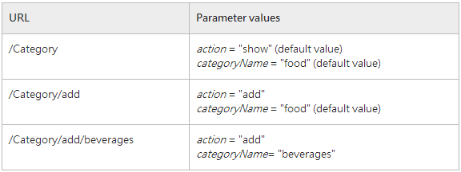
Routing Defaults
Routing applies defaults when URL section is not found.

Slide 18
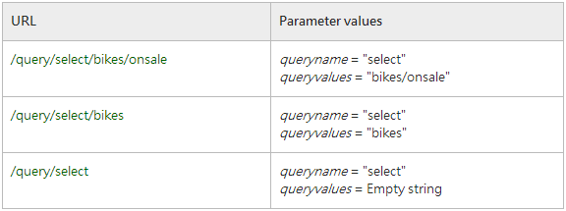
Variable URL section
Handle URL with a variable section.
query/{queryname}/{*queryvalues}

Slide 19

ASP.NET Routing

Slide 20
Declare a controller
Controller class
The base of all MVC controllers.
An implementation of HTTP handling infrastructure.
Helpers.
Filters.
Implement a simple controller
Place controller class in “Controller” folder.
Add a controller with postfix “Controller”
Inherit from Controller class.
Add a action method.

Slide 21
Declare a action
Action in controller is a method.
Return ActionResult type.
Indicate HTTP method of action to handle.
Binding parameter with Model Binder.
Interact model.
Response with ActionResult object.

Slide 22
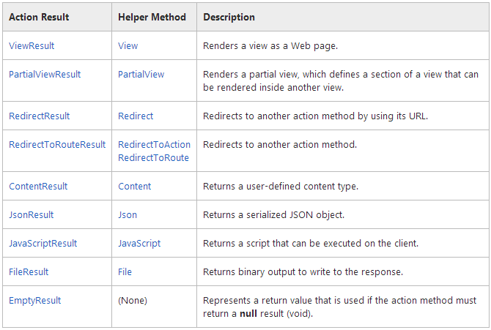
ActionResult

Slide 23
Customize ActionResult
Inherit from ActionResult base type.
Overwrite ExecuteResult() method.
Decide response content type.
Decide response encoding.
Decide response content.

Slide 24
Action Results

Slide 25
下半場

Slide 26
Model interactions
Consume data source from Model
LINQ to Entities
Call Web API or Web Services
Store result temporary
Model argument to view.
ViewDataDictionary: ViewData is a dictionary object that you put data into (key/value syntax).
ViewBag: The ViewBag object is a wrapper around the ViewData object that allows you to create dynamic properties for the ViewBag.
TempData: A very short instance storage. (Session)

Slide 27
ViewData, ViewBag and TempData

Slide 28
Model Binder
Use model as action parameter.
MVC Controller will apply parameter’s value from HTTP request body.
DefaultModelBinder class
Support simple model’s binding process.
Custom model binder
Complex or specific model source.
Implement IModelBinder interface (BindModel method)
Override the DefaultModelBinder’s methods.
Register model binder in Global.asax if global use.

Slide 29
Model Binder
The DefaultModelBinder obtains the Title parameter from the query string and passes it to the title parameter of the GetPhotoByTitle method, because the names match.
http://my.org/photo/getphotobytitle?title=myfirstphoto
DefaultModelBinder
public ActionResult GetPhotoByTitle (string title){
var query = from p in context.Photos
where p.Title == title
select p
Photo requestedPhoto = (Photo)query.FirstOrDefault();
return View("Details", requestedPhoto);
}

Slide 30
Model Binding

Slide 31
Model Binder
Binding Error
ModelState.IsValid (check any errors)
True if all model’s ModelState.Errors.Count = 0.
If any ModelState.Error.Count > 0, return false.
ModelState.AddModelError(): add model error in server-side code.
Indicate model’s error property.
Indicate model’s error message for property.

Slide 32
Model Validation
Data Annotation.
System.ComponentModel.DataAnnotation namespace.
Add validation rules with Attributes
Required
DisplayName
MaxLength
Range
DataType
StringLength
…

Slide 33
Model Validation
Declare model validation in POCO
Implement a metadata validation in LINQ to SQL, Entity Framework or other model cannot apply model validation attribute.
Declare model class as partial class.
Declare “MetadataType” in model class definition.
Implement metadata validation in other class.

Slide 34
Model Validation
Implement custom model validation element.
Create a attribute class and inherit from ValidationAttribute class.
Override “IsValid” and/or “FormatErrorMessage” methods.
Create a validation class and inherit from DataAnnotationsModelValidator class
Override “Validate” method to implement custom validation logics.
Register validation attribute and validator class in Global.asax
DataAnnotationsModelValidatorProvider.RegisterAdapter()

Slide 35
Model Validation

Slide 36
Accept File Upload.
Accept file upload.
Single: HttpPostedFileBase.
Multiple: IEnumerable<HttpPostedFileBase>
Implement file required in model.
Action must markup as accept HTTP POST OR PUT.
Download file
FileContentResult
FileStreamResult

Slide 37
Files

Slide 38
Handling HTML content
XSS attacks, CSRF attacks.
Avoid XSS attacks.
[ValidateInput(true)] for enable request validation, include HTML content (potential risk content).
Allow HTML inputs: [ValidateInput(false)], but you must force HTML content validation yourself (e.g. use AntiXSS library).
Avoid CSRF attacks.
[ValidateAntiForgeryToken] for enable server-side token validation.
Must generate token by using @Html.AntiForgeryToken() at view.

Slide 39
Handling Error
Handle error in action.
General error view.
Specific error (exception) view.
[HandleError]
General attribute declaration.
Apply with specified exception.
[HandleError(ExceptionType = typeof(Exception), View = “errorView”)]
You can apply multiple attributes in one action.

Slide 40
Filters
Filter is a pipeline-styled processor for action is invoking for specific requirements.
Aspect-Oriented Programming (AOP)
ASP.NET MVC built-in filters:
HandleErrorAttribute
OutputCacheAttribute
AuthorizationAttribute
RequiredHttpsAttribute

Slide 41
Filters
Authorization filters.
[Authorize], [RequireHttps]
Action filters.
Result filters.
[OutputCache]
Exception filters.
[HandleError]

Slide 42
Filters
Authorization Filter
Restrict action cannot access by unauthorized users or roles.
[Authorize] for authorize to authenticated users.
[Authorize(Role = “role1, role2”)] for authorize to authenticated users with role1 and role2.
[Authorize(User = “user1, user2”)] for authorize to authenticated user1 and user2.
Return HTTP 401 for unauthorized users.

Slide 43
Filters
HTTPS restriction
Apply [RequireHttps] to actions (or configure as Global filter) to ensure client connected by HTTPS (SSL/TLS).
Configure IIS to use server certificate and enable SSL connection.
Configure firewall to open TCP port 443 for HTTPS connection.

Slide 44
Filters
Implement custom filter
IAuthorizationFilter
OnAuthorization
IExceptionFilter
OnException
IActionFilter
OnActionExecuting
OnActionExecuted
IResultFilter
OnResultExecuting
OnResultExecuted

Slide 45
References
Controllers and Action Methods in ASP.NET MVC Applications
ASP.NET Routing
Controller Action Result
ViewData, ViewBag, TempData and Session
Model Binding
Model Validation
Filters

Slide 46

學習 MVC，你可以選擇…
由 5 位 MVP 合作執筆。
其中三位是 twMVC 社群成員，二位創始人。
台灣最暢銷的 ASP.NET MVC 中文書。
針對 Model, LINQ, EF, View 等重要議題完整涉獵。
範例程式置於 Github 可隨意下載取用。

Slide 47
高雄在地的 .NET 社群
才剛成立 ☺
每週三聚會和讀書會
星巴克裕誠店 (近捷運巨蛋站)
Clean Coder 讀書會進行中。
想請教，想閒聊都行 ☺
下一季視進度，會有實體研討會。
MVC
HTML5/Cordova
IoT
Welcome to join us! http://on.fb.me/1b4UPZS

Slide 48
Thank you!

